Slide 1

AOLME Curriculum SESSION 1
MATERIALS DEVELOPED BY THE AOLME PROJECT AT THE UNIVERSITY OF NEW MEXICO, PLEASE DO NOT COPY OR DISTRIBUTE ANY OF THESE COPYRIGHTED TASKS WITHOUT PROPER AUTHORIZATION OF PROJECT

Slide 2


Level 1
SESSION 1: Basic of Raspberry PI and Linux-(motivational overview of projects-images, ls, cd, to find previously made files) SESSION 2: Introduction to Python (print, for, if) SESSION 3: Algorithms (for loops-arithmetic progressions, if statements-ranges, inequalities) SESSION 4: The Coordinate Plane and Black & White Images in Python SESSION 5: Binary and Hexadecimal number systems SESSION 6: Images and Their Components (histograms) SESSION 7: Creation of Images and Video FINAL PROJECT: VIDEO

Slide 3
Basics of Raspberry PI and Linux
OBJECTIVES:
Explore, identify, and name a computer’s components across systems (PC and Raspberry).
Describe how information flows in a computer system.
Utilize basic Linux commands to navigate filesystems in a Raspberry Pi.
Practice assembling components and cables of a computer system.

Slide 4

Selected ACTIVITIES
1. Components of a computer and the Raspberry Pi
2. Assembly of the Raspberry Pi components and internal data flow in Computers
3. Navigation of directories and basic commands in Linux

Slide 5

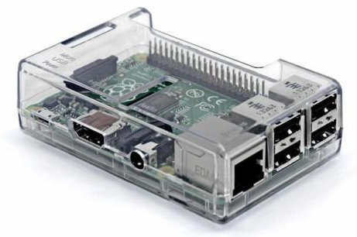
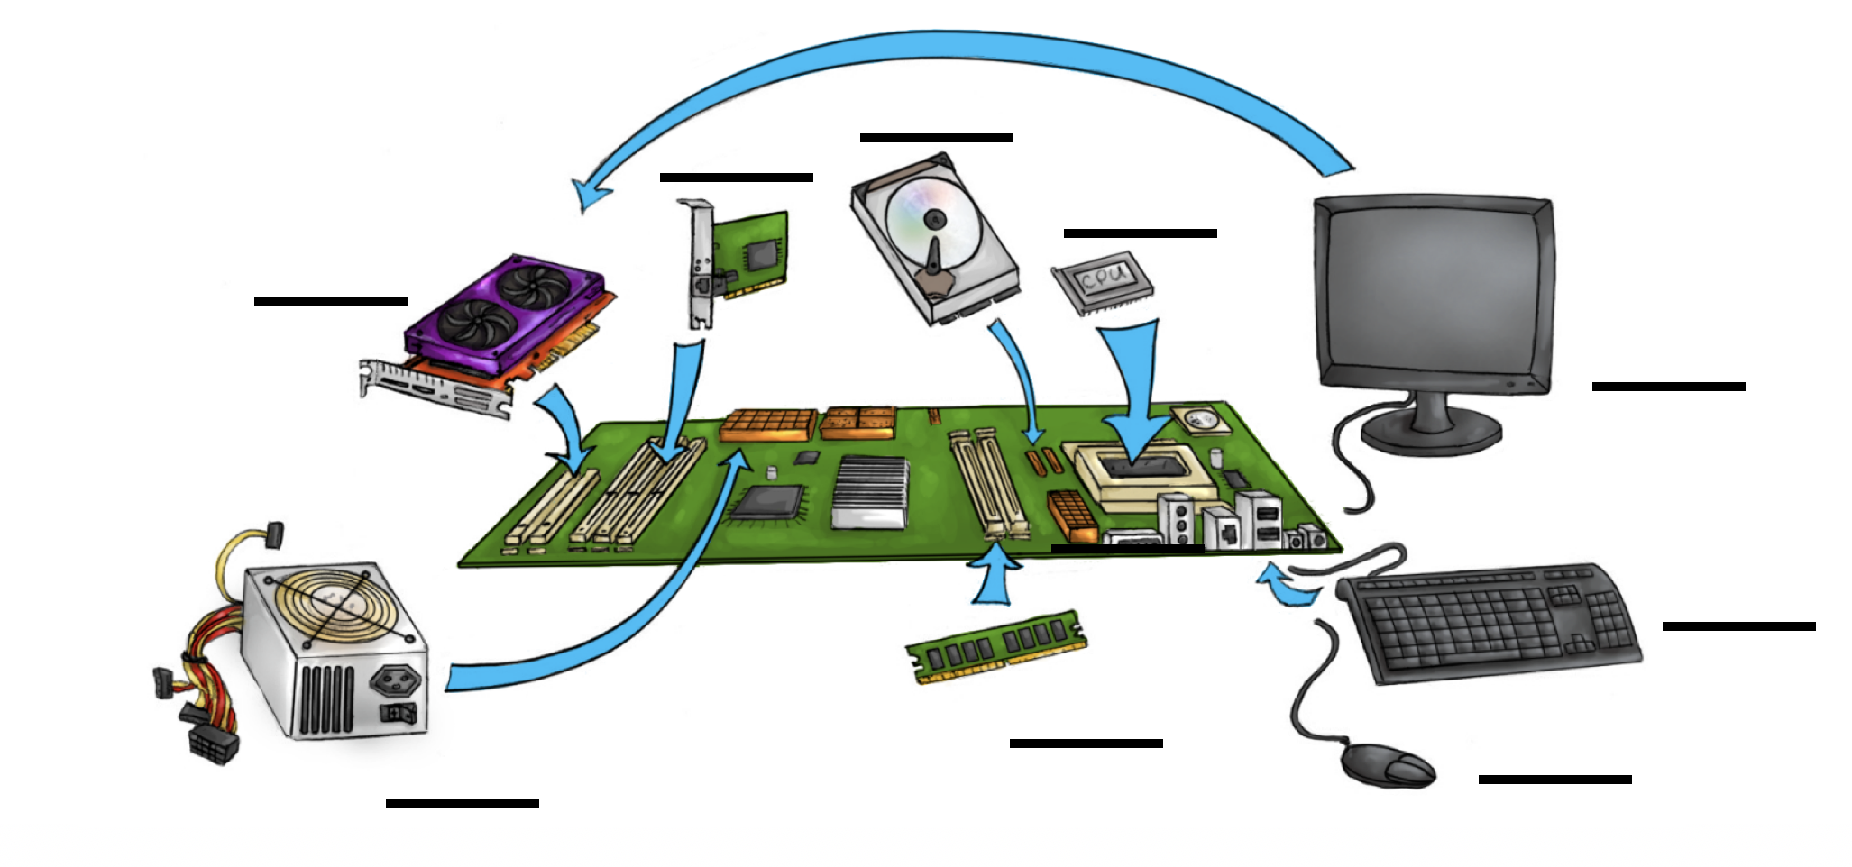
1.1. Components of a Computer & the Raspberry Pi
Think & Talk: What do you know about computers? What do you think a Personal Computer (PC) is? What’s a Raspberry Pi? What are the components or parts of a computer?
ID the parts: In your team, shuffle the white cards and take turns randomly selecting a card. As a card is selected, try both: (a) point to and find that part on an old real-life computer, and (b) name each component or part.
3. Play: (a) Make card columns by color and match them. Note: green cards = component names; yellow cards = descriptions, & white cards = visuals.
(b) Turn upside down and mix up all cards and play memory. To play: take turns flipping over a card of each color at a time, if they all match, keep them; if not, turn cards back upside down. Wins who finds > matches.
4. Link systems: With your team, take turns identifying and matching each part of a computer system with a Raspberry Pi system.
What would be another way to play the game?
AOLME PROJECT - LEVEL 1- SESSION 1- 2018
MATERIALS DEVELOPED BY THE AOLME PROJECT AT THE UNIVERSITY OF NEW MEXICO, PLEASE DO NOT COPY OR DISTRIBUTE ANY OF THESE COPYRIGHTED TASKS WITHOUT PROPER AUTHORIZATION OF PROJECT

Slide 6

1.1. Components of a Computer & the Raspberry Pi
Resources for the Activity
Recommended Steps for the Activity
Activity Card
3 decks of cards (white, yellow, green) with names, definition, visual of computer parts
Raspberry Pi
Old real-life computer
Student journal
Have students have an informal conversation about computers that can lead to recalling the names of the parts of a computer.
Use a real computer to ID those parts.
Before playing the memory game, make sure students (mostly on their own) accurately connect the names, visuals, and descriptions of the parts.
Have students practice these links by playing memory. Make it less about a competition, and focus on understanding. Check if words in cards make sense.
Make it fun! Have students make decisions on playing the game.
Have students lead the making connections across computer systems. Use the Raspberry Pi!!
Everyone in the team gets to play a role:
Discussion Expert: Leads the team discussion asking questions about what the session is about.
Fair Participation Expert: makes sure of fair participation of everyone.
Hardware Setup/Teardown Expert: in charge of setting up & putting away materials and computer equipment.
Summary Expert: summarizes and records team questions and what the teams has learned.
Activity 1 Goal: Explore, identify, and name a computer’s components across systems (PC and Raspberry).
AOLME PROJECT - LEVEL 1- SESSION 1- 2018
MATERIALS DEVELOPED BY THE AOLME PROJECT AT THE UNIVERSITY OF NEW MEXICO, PLEASE DO NOT COPY OR DISTRIBUTE ANY OF THESE COPYRIGHTED TASKS WITHOUT PROPER AUTHORIZATION OF PROJECT
Notes:
Reduce number of codes P
Provide examples of images and how they were pixelated

Slide 7
Components of a Computer
RAM
Random Access Memory
GPU
Graphics Processing Unit
Hard drive
PC
Camera
Power Supply for Personal Computer (PC)
Ethernet Port
Ethernet card for Personal Computer (PC)
CPU
Central Processing Unit
Portable Power Supply
Secure Digital
(SD)
Memory Card
Motherboard
Raspberry Pi Camera
AOLME PROJECT - LEVEL 1- SESSION 1- 2018
MATERIALS DEVELOPED BY THE AOLME PROJECT AT THE UNIVERSITY OF NEW MEXICO, PLEASE DO NOT COPY OR DISTRIBUTE ANY OF THESE COPYRIGHTED TASKS WITHOUT PROPER AUTHORIZATION OF PROJECT
Notes:
Reduce number of codes P
Provide examples of images and how they were pixelated

Slide 8
Components of a Computer
It is used to store all programs and data that will be processed by CPU. When the computer is turned off, the memory is lost.
Stores program files and data. Everything stays here even if the computer is turned off. This is used as permanent storage for the data.
It is used to process data fast. It reads its data from the RAM and writes the results to the RAM when done.
It connects to the computer externally. It is used by the computer to take pictures.
This is a connector. You can plug a cable to it so as to connect to a cable model to access the internet.
It supplies power to the different Personal Computer (PC) components.
It is used to supply power to small computers (e.g., Raspberry Pi) or a mobile phone.
It is used to store data securely. The data is not lost when the device is turned off.
It is used to connect the CPU to the memory, the power, and all other computer components together.
This is the brain of the computer. It tells everyone else what to do. It also performs mathematical operations
It is used to connect a Personal Computer (PC) to the internet.
It connects to the Raspberry Pi computer. It is then used to take pictures.
AOLME PROJECT - LEVEL 1- SESSION 1- 2018
MATERIALS DEVELOPED BY THE AOLME PROJECT AT THE UNIVERSITY OF NEW MEXICO, PLEASE DO NOT COPY OR DISTRIBUTE ANY OF THESE COPYRIGHTED TASKS WITHOUT PROPER AUTHORIZATION OF PROJECT
Notes:
Reduce number of codes P
Provide examples of images and how they were pixelated

Slide 9
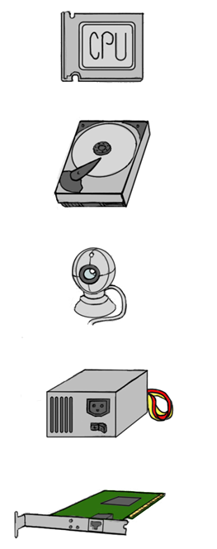

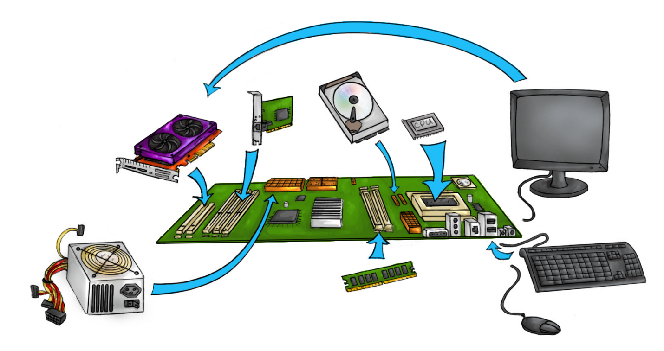
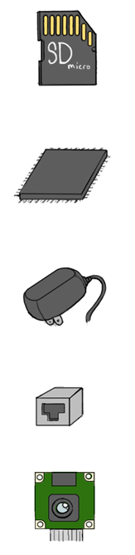

Components of a Computer
AOLME PROJECT - LEVEL 1- SESSION 1- 2018
MATERIALS DEVELOPED BY THE AOLME PROJECT AT THE UNIVERSITY OF NEW MEXICO, PLEASE DO NOT COPY OR DISTRIBUTE ANY OF THESE COPYRIGHTED TASKS WITHOUT PROPER AUTHORIZATION OF PROJECT
Notes:
Reduce number of codes P
Provide examples of images and how they were pixelated

Slide 10
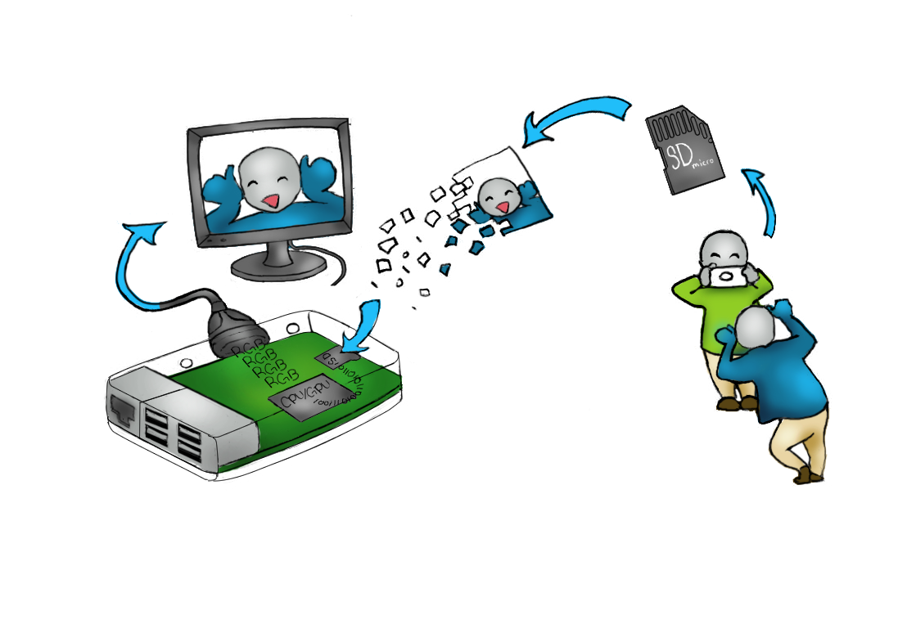

1.2. Computer Components and Data Flow
Think of another example of data flow
1. Think and Talk: What do you notice about the flow of the data in the computer parts? Use the illustration to talk about it.
2. Think, Talk, & Do: Work collaboratively in your team to put together the Raspberry Pi computer. As you do, use the terms you’ve learned.
-What is you favorite part? Why?
-What component is linked to the HDMI connector?
REMEMBER! Connect the power last.
MATERIALS DEVELOPED BY THE AOLME PROJECT AT THE UNIVERSITY OF NEW MEXICO, PLEASE DO NOT COPY OR DISTRIBUTE ANY OF THESE COPYRIGHTED TASKS WITHOUT PROPER AUTHORIZATION OF PROJECT
AOLME PROJECT - LEVEL 1- SESSION 1- 2018
Notes:
Reduce number of codes P
Provide examples of images and how they were pixelated

Slide 11
1.2. Computer Components and Data Flow
Resources for the Activity
Recommended Steps for the Activity
Have students describe the illustration of taking pictures as an example of data flow and create a story-like about the data flow. Elaborate on data flow ideas by having them further think about their own experiences at school using data on a computer.
Motivate students to use the names of the components of the computer as they talk. Model that type of talk to them as the team puts the computer system together.
Make sure all students participate in the assembly and ask them to describe using related vocabulary on what they are doing or how they connected those parts.
Have students describe their own experiences assembling computers at home or school.
Ask for any questions they might have and encourage team members to respond.
Activity Card
Raspberry Pi kit per group
Power strip
Monitor
Activity 2 Goals: (a) Describe how information flows in a computer system. (b) Practice assembling components and cables of a computer system.
AOLME PROJECT - LEVEL 1- SESSION 1- 2018
MATERIALS DEVELOPED BY THE AOLME PROJECT AT THE UNIVERSITY OF NEW MEXICO, PLEASE DO NOT COPY OR DISTRIBUTE ANY OF THESE COPYRIGHTED TASKS WITHOUT PROPER AUTHORIZATION OF PROJECT
Notes:
Reduce number of codes P
Provide examples of images and how they were pixelated

Slide 12


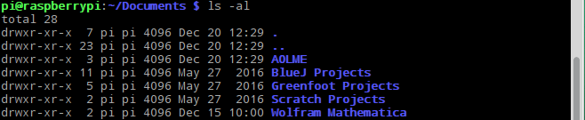
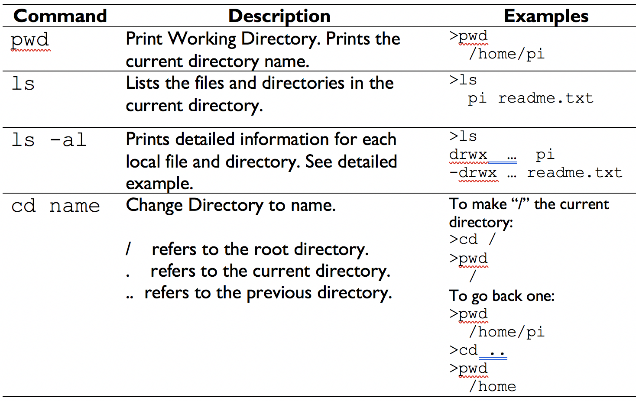
1.3.1. Linux Commands to Navigate the File System
Explore: The Graphical User Interface or GUI allows us to navigate the file system by clicking on small icons.
2. For working with a large number of files, we want to issue commands at the Linux Terminal. Open it by double clicking on its icon: To start, type ls -al and click enter. You will see something like:
To open a directory, use the GUI File Manager by double clicking on the folder icon. The taskbar appears on the left-top side of your monitor. How familiar are you with navigating the computer this way? Open and close 2 to 3 files.
The first letter “d” tells it’s a directory. If it were “-”, then it’d be a file. The text at the end (blue here) is the file or directory name. / refers to the root directory, . refers to the current directory, and .. refers to the previous directory. What else do you see? .
3. Work: There are many more commands. Try them out, take turns.
4. Challenge:
List all of the directories under /home/pi your team can find on your computer using the commands only.
You cannot use the GUI!
Hint: Start with the following:
cd /home/pi
ls -al
In your own words, what’s a command?
AOLME PROJECT - LEVEL 1- SESSION 1- 2018
MATERIALS DEVELOPED BY THE AOLME PROJECT AT THE UNIVERSITY OF NEW MEXICO, PLEASE DO NOT COPY OR DISTRIBUTE ANY OF THESE COPYRIGHTED TASKS WITHOUT PROPER AUTHORIZATION OF PROJECT

Slide 13
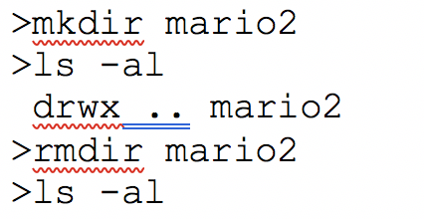
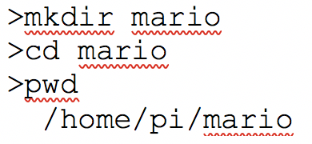

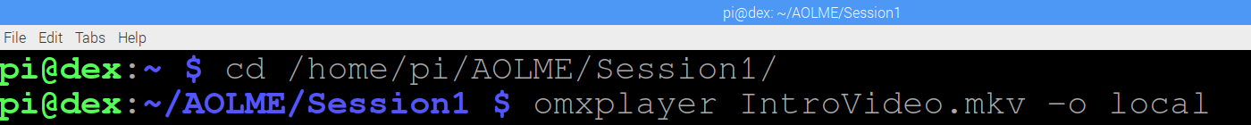
1.3.2. Linux Commands to Work with Directories
You can create directories using the command:
mkdir name
You can remove directories using the command:
rmdir name
What will these commands do? & Why?
What will these commands do? & Why?
Be careful: Once you remove a directory, you cannot
recover the files in that directory.
3. More commands: By using command prompt commands, you can move millions and billions of files between computers with simple commands!
You can find the most important commands by typing the
following address in your browser:
www.raspberrypi.org/documentation/linux/usage/commands.md
For Linux, type:
www.raspberrypi.org/documentation/linux/
Can you find the commands to add a new user?
4. Two Challenges: (a) With your team, create 3 directories: /home/pi/try1, /home/pi/try2, and /home/pi/try3. Then, erase them all.
(b) Open & watch a video:
To do this 1) Open "Terminal”
2) There type in "Jupyter notebook"
3) Click Enter.
Write: What Linux commands should you remember? How can you tell the directory levels?
AOLME PROJECT - LEVEL 1- SESSION 1- 2018
MATERIALS DEVELOPED BY THE AOLME PROJECT AT THE UNIVERSITY OF NEW MEXICO, PLEASE DO NOT COPY OR DISTRIBUTE ANY OF THESE COPYRIGHTED TASKS WITHOUT PROPER AUTHORIZATION OF PROJECT

Slide 14
1.3. Linux: Directory Navigation & Basic Commands
Resources for the Activity
Recommended Steps for the Activity
Have students think about how they usually navigate computers and use that to think about this session.
Motivate students to take turns typing in commands, so that all of them have similar participation.
Let students pay attention to what is happening when commands are typed, and ask students who are not typing to describe what is happening and why. If the group wants, create own names for directories.
Have students debrief what they learned at the end of the session and write in their journal at least 3 thoughts.
Promote collaboration by listening to and helping each other. An error is just a step to get better.
Activity Card
Raspberry Pi kit
Student journal
Evaluate how did the team roles work?
Discussion Expert: Leads the team discussion asking questions about what the session is about.
Fair Participation Expert: makes sure of fair participation of everyone.
Hardware Setup/Teardown Expert: in charge of setting up & putting away materials and computer equipment.
Summary Expert: summarizes and records team questions and what the teams has learned.
Activity 3 Goal: Utilize basic Linux commands to navigate filesystems in a Raspberry Pi.
AOLME PROJECT - LEVEL 1- SESSION 1- 2018
MATERIALS DEVELOPED BY THE AOLME PROJECT AT THE UNIVERSITY OF NEW MEXICO, PLEASE DO NOT COPY OR DISTRIBUTE ANY OF THESE COPYRIGHTED TASKS WITHOUT PROPER AUTHORIZATION OF PROJECT
Notes:
Reduce number of codes P
Provide examples of images and how they were pixelated

Slide 15
1.4. Linux Commands to Play the Video ?????
Open the terminal.
2. Open the terminal by double clicking on its icon:
3. Work: There are many more commands. Try them out, take turns.
4. Challenge:
In your own words, what’s a command?
AOLME PROJECT - LEVEL 1- SESSION 1- 2018
MATERIALS DEVELOPED BY THE AOLME PROJECT AT THE UNIVERSITY OF NEW MEXICO, PLEASE DO NOT COPY OR DISTRIBUTE ANY OF THESE COPYRIGHTED TASKS WITHOUT PROPER AUTHORIZATION OF PROJECT

